Slide 1
The potential to generate organic hydrogen
John Hanson 04/07/2023
Notes:
Today I would like to try to convince you of the potential for hydrogen to be considered as part of the hydrocarbon generation system.
Within this framework there is scope to expand upon earlier ideas of matrix and nanoscale thermo-catalytic reactions which lead to hydrogen generation.

Slide 2
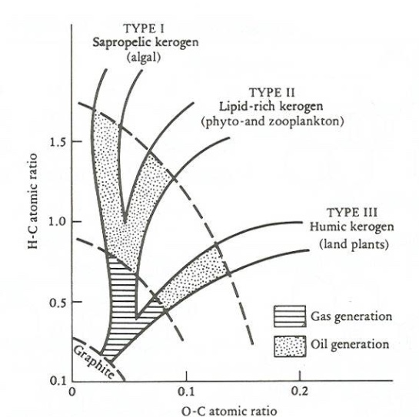
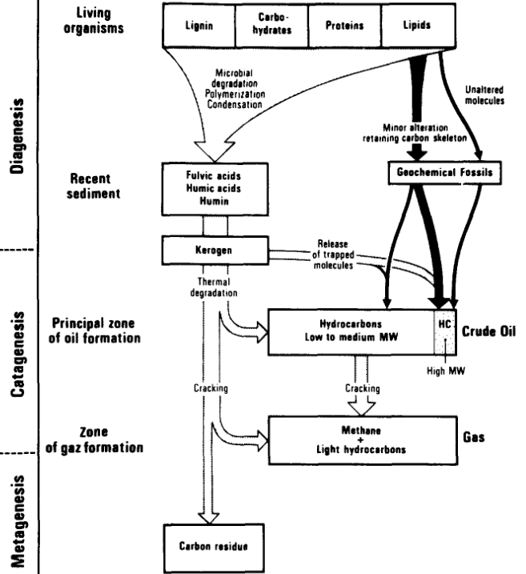
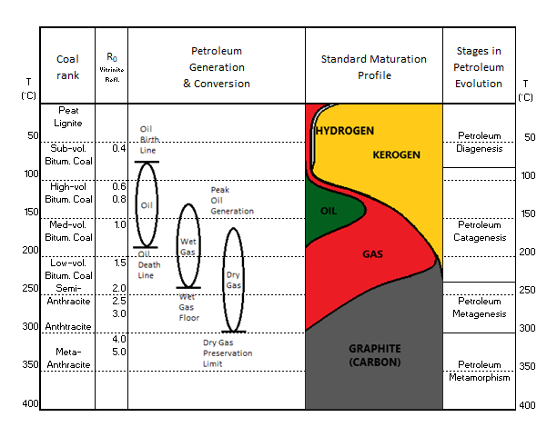
Bulk hydrocarbon models maybe incomplete
Van Krevelen Diagram 1951
Tissot and Welte 1984
Basic concept
Notes:
The bulk reactions which we normally associate with hydrocarbon generation tend to ignore matrix and nanoscale reactions and so only allow limited scope for hydrogen generation.

Slide 3
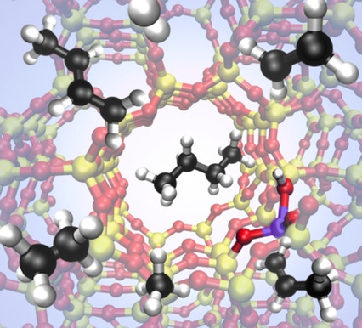
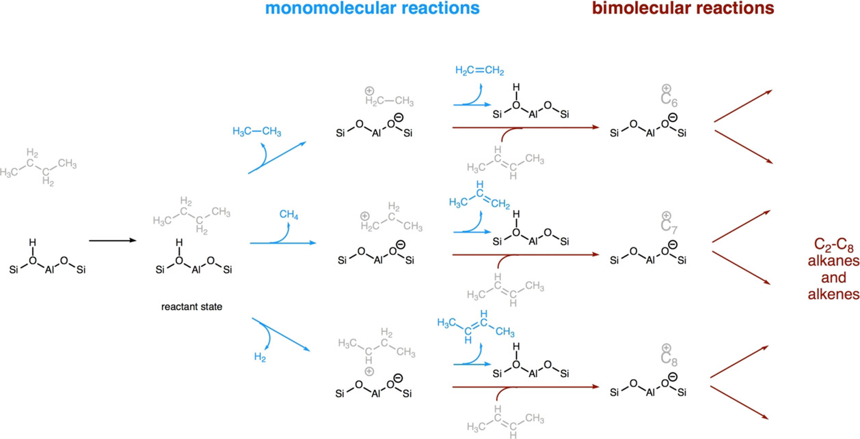
Study Whitmore reactions at low conversion rates
Brønsted acid site inside xeolite
Nanostructure observations at low conversion rates favour monomolecular reactions which differ at high conversion rates
Pictures courtesy of J. Van der Mynsbrugge, A. Janda, L.-C. Lin, V. Van Speybroeck, M. Head-Gordon and A. T. Bell. https://doi.org/10.1002/cphc.201701084
Notes:
As an example we can see that work by Van der Mynsbrugge et Al that cracking of alkanes by zeolites when tuned for nanoscale and low conversion rates produces a different result to bulk reactions. In particular note that some diatomic hydrogen is created.

Slide 4
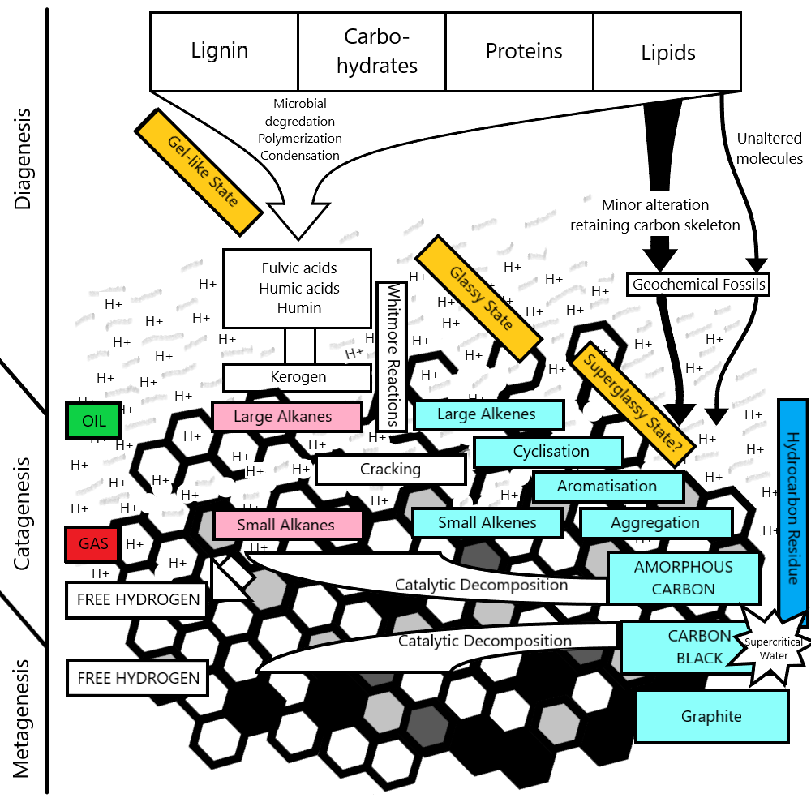
Potential of organic hydrogen in the subsurface
Bulk reactions maybe misrepresenting the alternate mechanisms in the subsurface.
Low conversion rate nanoscale thermo-catalytic matrix reactions at low temperatures link to create hydrogen.
Clay catalyses kerogen via Whitmore reactions - hydronium acts as mobile Brønsted acid site.
Authigenic amorphous carbon takes over clay as shorter chains less easy to crack - H2 evolved as short chains decompose.
Hydrocarbon residue cracked by super- critical water @ 370 ⁰C.
Carbon black converts hydrocarbon residue & second gas peak into H2.
Notes:
What I’d like to tell you is:- Diagenesis may be influenced to some degree by super Arrhenius conditions which appear to reduce the energy hurdles leading to early initiation of Whitmore reaction conditions persisting through oil development.
It is possible that low conversion rate nanoscale thermo-catalytic reactions maybe follow on from one to the other creating hydrogen.
1. Clay catalysis cracking and polymerisation
2. Amorphous carbon catalysis induced cracking
3. Carbon black catalysis induced cracking
There are two themes of note:
A. Initial production of hydronium by clay catalysis promoting Whitmore type carbocation exchanges in cracking and polymerisation.
B. Conversion of cracked alkenes to form “hydrocarbon residues” in a glassy or super-glassy state which are eventually transformed into amorphous carbon and forming graphite as the end product. This covers the various types of bitumen created by the cracking mechanism but for the sake of simplicity is lumped together.

Slide 5
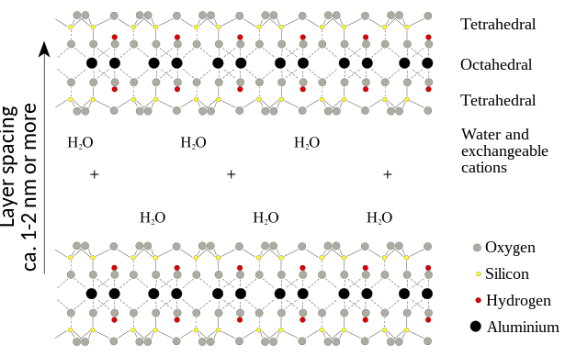
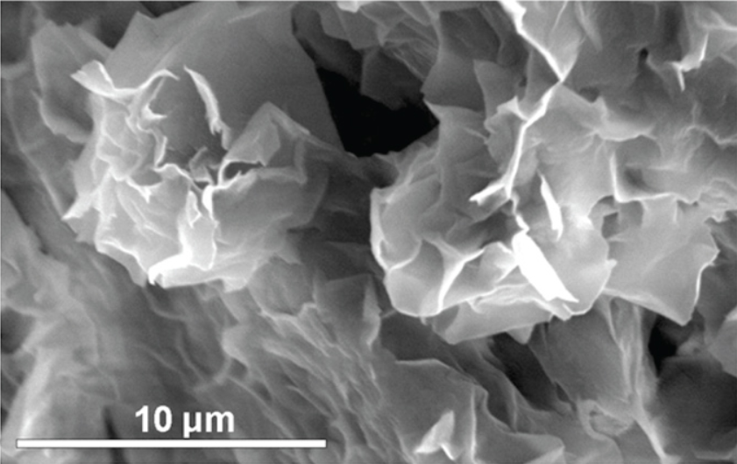
Smectite family nanostructure layered topology
TOT Layer
Interstitial water protonised via cation exchange and emerges as mobile Brønsted acid site.
H₃O⁺
TOT Layer
Montmorillonite structure, with English labels, 2007. German version by Andreas Trepte, translated by User:Itub. With thanks to Wiki Media Commons.
Notes:
We are most familiar with the idea of clays acting as a catalyst in the subsurface.
We typically think of organo-clay complexes where gigantic organic molecules are adsorbed onto the outer surface of clays.
More recently though the role of hydronium as a mobile Brønsted acid site have become popular.
Water in the interlayer of the clays becomes protonated and is free to react externally.

Slide 6
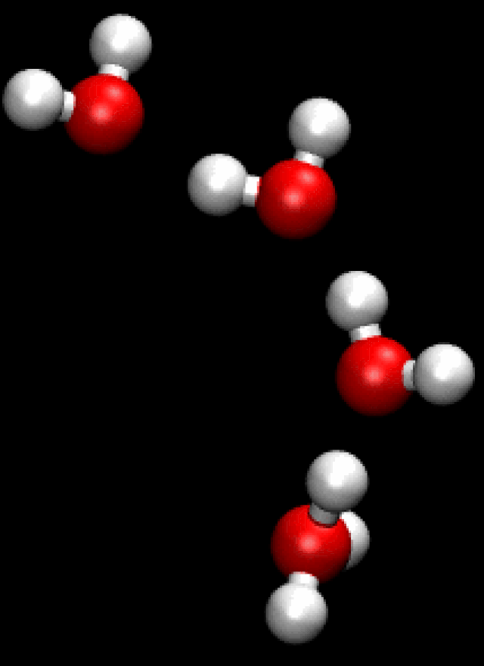
Conversion of Smectite to Illite releases hydronium
Release of hydronium due to collapse of Smectite layers not new, Linares et Al, 1992.
The volume of hydronium produced is and its freedom to migrate.
Does hydronium release if no organics?
Hydronium acts as mobile Brønsted acid site.
Acidic conditions continue from diagenesis favouring Whitmore reactions.
Mobility of hydronium is key to alkene polymerisation, making it into superglassy chemically inert heteromolecule prior to conversion to highly reactive amorphous carbon.
Animation courtesy of Wikimedia Commons
Notes:
Here we can see in the animation of the Grotthuus Mechanism.
It is thought that a hydronium complex is formed from cations in the TOT layer of the clay react with interlayer water allowing proton hopping.
This means that hydronium ions can easily migrate through the nanopore space in the shale and more easily cause Whitmore type cracking and polymerisation reactions.

Slide 7
Nanoscale Whitmore reactions at low conversion
Interlayer Brønsted acid sites cracks alkanes dependant on size and topology
+
H₃O⁺
H₂O
R
Carbocation protonates water
R
+
R
H₂O
H₃O⁺
R
Due to topology longer chain alkanes more easily react on interlayer edges or with hydronium as a mobile Brønsted site outside of Smectite lattice
R
Notes:
The large interlayer space of Smectite may allow small alkanes to pass though and be cracked.
Hydronium created through cationic exchange in the interlayer acts as a mobile proton exchange site in both cracking and polymerisation.

Slide 8
Clay exhaustion and Whitmore switch off
R
R
H₃O⁺
H₃O⁺
R
H₃O⁺
H₃O⁺
H₃O⁺
H₃O⁺
H₃O⁺
H₃O⁺
R
H₃O⁺
H₃O⁺
H₃O⁺
H₃O⁺
H₃O⁺
H₃O⁺
H₃O⁺
Smectite reactivity wains and Whitmore reactions reduce as TOT layers collapse.
Illite is formed trapping remaining hydronium and increasing pH. This expels alkanes from micro and nanopores leading to isolation of more difficult to crack alkanes.
Notes:
Hydronium creation eventually leads to collapse of smectite and the creation of a more stable illite structural configuration.
The collapse in the micro and nano pore structure leads to expulsion of adsorbed alkanes and hydrogen.
Collapse also severely inhibits or stops the Whitmore reactions from occurring.
Increases in pH and temperature begin to favour another catalytic mechanism involving radical reactions.

Slide 9
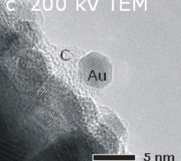
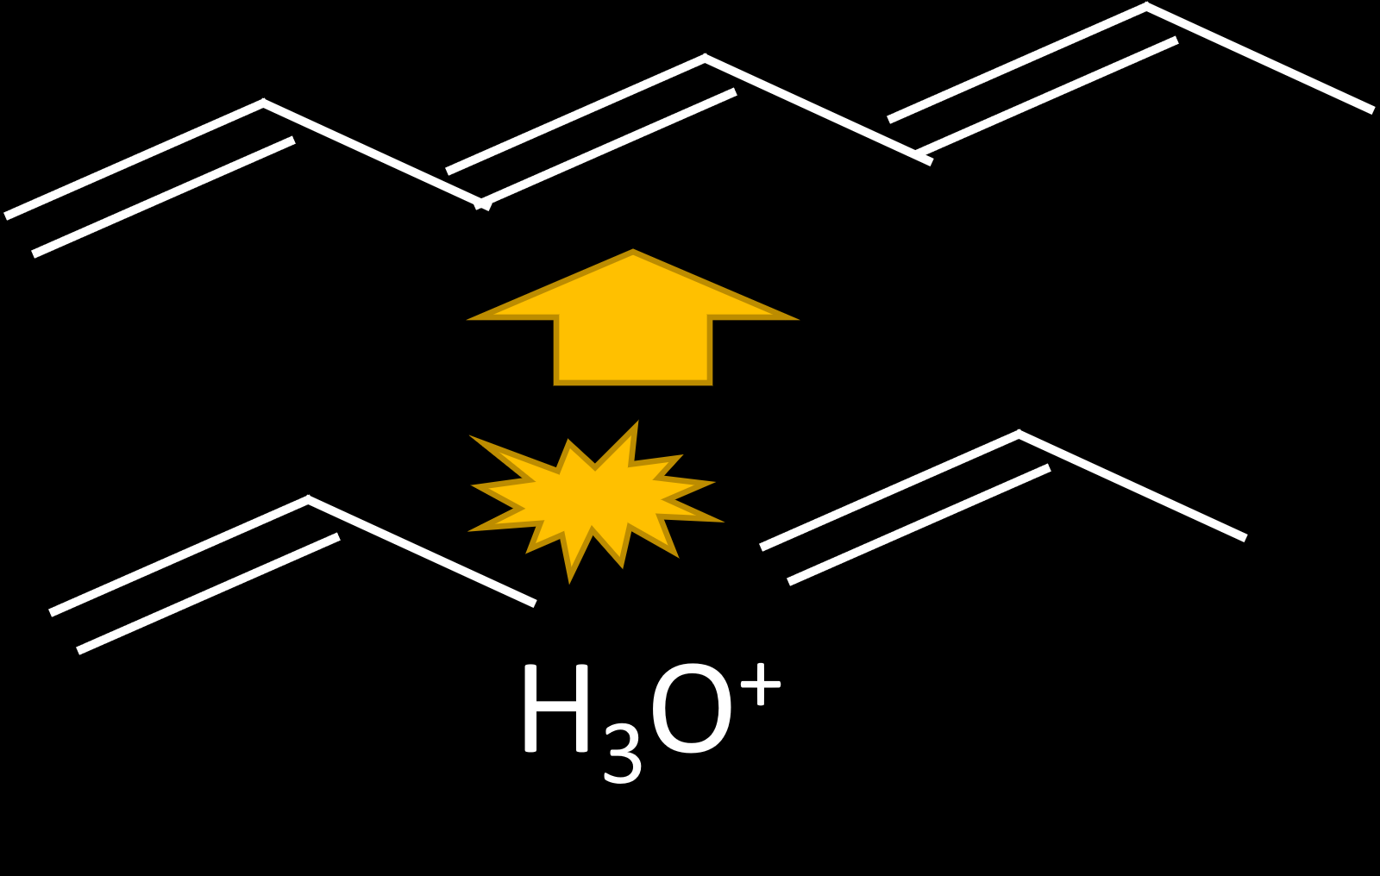

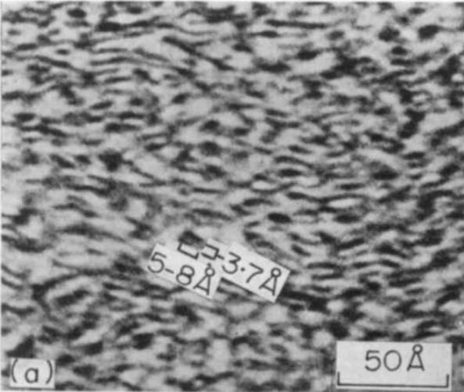
Meanwhile alkenes mature into amorphous carbon
Whitmore reactions polymerise alkenes produced by cracking.
Cyclisation and aromatisation reactions persist creating connected graphene islands.
Gigantic, inert heteromolecules produced aggregate in cross linked glassy to superglassy state.
Incremental chain transfer reactions and dehydrogenation convert to amorphous carbon.
Notes:
One of the key mechanisms of the hydrocarbon model that is often overlooked is the creation of coke and hydrocarbon residues.
Mobile Bronsted acid sites catalyse polymerisation, cyclisation and aromatisation reactions.
This creates a series of inert gigantic hetero-molecules cross linked or connected by cyclic ribbons with “islands” of graphene.
These grow and develop through chain transform reaction (amongst others) releasing hydrogen and increasing the C:H ratio.
Eventually amorphous carbon develops.

Slide 10
Adsorption reactions on the subsurface of amorphous carbon key to process
Adsorption
Chemisorption
Carbon Insertion
Decompostion
C_{Ac}…C + 2C₂H₆
2C_{Ac} + 2C₂H₆
C_{Ac} + C₅H₁₂
C_{Ac}…C₅H₁₂
C_{Ac}…C + C₃H₈ + CH₄
2C_{Ac} + C₃H₈ + CH₄
C_{Ac} + C₄H₁₀
C_{Ac}…C₄H₁₀
C_{Ac}…C + C₂H₆ + CH₄
2C_{Ac} + C₂H₆ + CH₄
C_{Ac} + C₃H₈
C_{Ac}…C₃H₈
C_{Ac}…C + 2CH₄
2C_{Ac} + 2CH₄
C_{Ac} + C₂H₆
C_{Ac}…C₂H₆
C_{Ac}…C + H₂ + CH₄
2C_{Ac} + H₂ + 2CH₄
C_{Ac} + CH₄
C_{Ac}…CH₄
C_{Ac}…C + 2H₂
2C_{Ac} + 2H₂
Expelled alkanes from collapse of smectite adsorb onto amorphous carbon.
Growth of amorphous carbon by insertion from short chain alkanes during decomposition.
Only methane and ethane create hydrogen.
Notes:
The collapse of smectite to form illite has expelled alkanes and hydrogen from the nano and micro pores of the clays causing some expulsion.
There is also increased absorption and adsorption onto the surface of and into the pores of amorphous carbon as it reaches activation temperature.
This is a similar situation to what is noted in some gas shales in say the Permian gas basin in the USA.
At the same time temperatures are at an appropriate level to activate amorphous carbon.
The switch on of amorphous carbon allows short chained alkanes to be cracked.
Only ethane and methane have decomposition components which give rise to hydrogen.

Slide 11
Chemistry of active sites on amorphous carbon are complicated
While amorphous carbon has been growing the surface has adsorbed molecules creating more active sites.
Reactions with H₂O and CO₂ have created highly active oxidation sites.
OH
O
Armchair
O
Bay
Ether
Gulf
Carboxyl
Phenol
Fjord
OH
Cove
O
Quinone
O
Carbonyl
Zig Zag
O
Notes:
The simplistic view of amorphous carbon and its absorbates are actually a lot more complex.
We often think of amorphous carbon as being pristine. However in the subsurface as hydrocarbon residue matures into amorphous carbon the surface reacts with water supercritical CO₂ and other molecules creating a graphene oxide type structure.
In numerous bulk reactions with amorphous carbon the surface of Ac is often oxidised in a similar manner to reactivate annealed catalyst by creating an abundance of new active sites.
For simplicity lets focus on the reaction of the cracking of methane at an active site to try to understand how amorphous carbon may grow whilst creating diatomic hydrogen.

Slide 12
Growth of amorphous carbon as alkanes crack
Focus exclusively on one area of activity.
Ignore the complications momentarily.
Methane is attracted.

Slide 13
Growth of amorphous carbon as alkanes crack
Methane is adsorbed.
…but doesn’t yet react.

Slide 14
Growth of amorphous carbon as alkanes crack
Water is adsorbed too.
It acts as a bridge for the reaction.

Slide 15
Growth of amorphous carbon as alkanes crack
It acts as a bridge for the reaction.

Slide 16
Growth of amorphous carbon as alkanes crack
Existing bonds weaken.

Slide 17
Growth of amorphous carbon as alkanes crack
Old bond is broken and new ones created.

Slide 18
Growth of amorphous carbon as alkanes crack
Carbon of methane begins insertion into ring structure.

Slide 19
Growth of amorphous carbon as alkanes crack
New sigma bonds between carbons form.

Slide 20
Growth of amorphous carbon as alkanes crack
New sigma bonds between carbons form.

Slide 21
Growth of amorphous carbon as alkanes crack
Linking hydrogen of methane is incorporated by water.

Slide 22
Growth of amorphous carbon as alkanes crack
Hydrogen bond simultaneously weakens.

Slide 23
Growth of amorphous carbon as alkanes crack
Water detaches as sigma bonds strengthen. The remaining methyl radical begins to disassociate.

Slide 24
Growth of amorphous carbon as alkanes crack
Hydrogen bonds weaken further for all hydrogen atoms.
Active sites weaken as sigma bonds form.

Slide 25
Growth of amorphous carbon as alkanes crack
Sigma bonds strengthen.
The remaining methyl radical begins to disassociate.

Slide 26
Growth of amorphous carbon as alkanes crack
The first of the methyl hydrogen atoms detatches.
Rapidly followed by any remaining.

Slide 27
Growth of amorphous carbon as alkanes crack
Detached hydrogen atoms react to form diatomic hydrogen.

Slide 28
Growth of amorphous carbon as alkanes crack
Evolved diatomic hydrogen is expelled.

Slide 29
Growth of amorphous carbon as alkanes crack
Hydrogen evolves as amorphous carbon grows from active sites.
Amorphous carbon deactivates.

Slide 30
Organic decomposition favoured…for reasons unknown!
“During heating, carbon particles are activated in the presence of hot combustion gases (steam-CO2 mixture) and acquire catalytic activity toward methane decomposition reaction. Thus, carbon particles are interconverted throughout the process (from deactivated to catalytically active and vice versa), which insures the sustainability of the process.”
  N. Muradov; Z. Chen; F. Smith (2005). Fossil hydrogen with reduced emission: Modeling thermocatalytic decomposition of methane in a fluidized bed of carbon particles. , 30(10), 1149–1158. doi:10.1016/j.ijhydene.2005.04.005
“It is well known that generation of surface area by activation of a carbonaceous material proceeds removing carbon atoms from the surface. The ratio of mass removed is known as burnoff. Consistently, to assure the sustainability of the process, it should be stated that the burn-off during the regeneration stage (the carbon mass removed from a deactivated carbon particle) is lower that the ratio of carbon deposited during the subsequent methane decomposition stage. In other words, removing of a given quantity of carbon mass from a carbon particle would enable the particle to accommodate a higher quantity of mass carbon in the subsequent decomposition cycle. A mechanism of how that would occur has not been proposed yet.”
  J.L. Pinilla; I. Suelves; R. Utrilla; M.E. Gálvez; M.J. Lázaro; R. Moliner (2007). Hydrogen production by thermo-catalytic decomposition of methane: Regeneration of active carbons using CO2. , 169(1), 103–109. doi:10.1016/j.jpowsour.2007.01.045
Notes:
It has been observed experimentally for some time that there may be some mechanism for the reactivation and growth of amorphous carbon to allow decomposition of alkanes in a continuous system.

Slide 31
Langmuir-Hinshelwood mechanism – multiplicity of islands of differing adsorbates react…
Adsorption
Chemisorption
Decompostion
C_{Ac} + CH₄
C_{Ac}…CH₄
C_{Ac}…C + 2H₂
2H₂ + 2C_{Ac}
Diatomic hydrogen evolved
C_{Ac} + 2H₂O
C_{Ac}…H₂O
C_{Ac}…C + 2H₂O
2H₂ + CO_{2g}
Release creates more active sites and process continues
Adsorption
Abstraction
Reactivation of Ac
2C_{Ac} + CO₂
2C_{Ac}…CO₂
C_{Ac}…C…CO₂
C_{Ac} + 2CO_{g}
2C_{Ac} + H₂
2C_{Ac}…H
Interruption of reverse water gas shift reaction to create phyllosilicates.
C_{Ac}…CO₂ + C_{Ac}…H
C_{Ac}…CO +
C_{Ac}…OH
C_{Ac}…OH + C_{Ac}…H
2C_{Ac} + H₂O
Stoichiometric dehydration of rocks during low grade metamorphism by sequential transformations from one hydrous mineral assemblage to another anhydrous one favours eventual free hydrogen production.
Notes:
Adsorption is key and can be thought of as adhesion of ions or molecules onto a surface.
This may in some way help to balance instability in the lattice caused by the active sites and leads to a build up many layers thick of absorbates creating islands clumped together as in the Langmuir – Hinshelwood mechanism.
There are two interdependent series of reactions:
Firstly is the annealing and deactivation of amorphous carbon by the decomposition of small chain alkanes producing hydrogen.
The second is dependent upon adsorption of water to create CO and CO₂ which desorbs from the surface and abstracts carbon from the amorphous surface lattice and rejuvenates the catalyst. Carboxyl and carbonyl groups may be intermediates species most likely to create CO and CO₂.
The second process is governed by the interruption of the reverse water gas shift reaction by chlorite growth as it develops from illite incorporating water into its lattice.

Slide 32
The end of the beginning…
Amorphous carbon becomes deactivated as chlorite incorporates water into its lattice.
The decomposition of alkanes decreases due to annealing of active reaction sites.
Amorphous carbon turns to carbon black.
Expulsion and consumption of dry gas to create diatomic hydrogen ends the process.
Gigantic unreactive heteromolecules (hydrocarbon residue) still remain locked up in the shale in a glassy or super glassy state…
The beginning of the end
Temperatures and pressures reach super-critical…
Notes:
This is the end of the beginning of diatomic hydrogen generation as chlorite growth shuts down hydrogen generation and amorphous carbon deactivates turning to carbon black.
Reduction in nanopore space leads to the expulsion of dry gas and diatomic hydrogen.
Unreactive hydrocarbon residues remain locked into the shale.
This is also the beginning of a new phase of thermo-catalysis as conditions become super-critical…

Slide 33
A super-critical water primer
Above critical point both gas particle and liquid particles have near zero or near equal intra and intermolecular forces acting on them.
Gas and liquid have same density – Near zero / near equal intermolecular forces produce similar molecular packing in both so they have same density , in the case of water, about 0.32 g/cc .
Small changes in pressure or temperature result in large changes in density.
SCW becomes a nonpolar solvent- Since no intra and no intermolecular forces exist, the surface tension of supercritical water is zero. At low / near zero surface tension the supercritical water becomes a solvent for nonpolar compounds and does not dissolve polar ionic compounds.
For same above reasons, viscosity and dielectric decreases in supercritical water.
Viscosity decreases in supercritical water because the molecules do not exist as cluster .
Dielectric decreases as supercritical molecules are nonpolar.
Auto-dissociation of water increases.
Latent heat or heat of vaporization is zero - Nonexistence of intra/intermolecular forces above critical point do not require any additional heat to break bonds
Above critical point water vapor cannot be liquefied by increasing pressure - Nonexistence of intra/intermolecular forces above critical point do not allow transformation of vapor to liquid with increased pressure.
Notes:
As a quick reminder to those that have forgotten some of the peculiarities associated with super-critical water.
The main points are that water now has no surface tension and becomes a non-polar solvent.

Slide 34
Water becomes super-critical dissolving hydrocarbon residue
At supercritical temperatures chlorite dehydrates and forms garnet.
Free super-critical water dissolves hydrocarbon residues.
For example in SCW turns Benzenes -> Phenols -> Liquids -> Gases -> “Char”.
Secondary dry gas peak formed creating source of organics to decompose to H₂.
Super-critical water attacks the surface of carbon black and reactivates it forming an amorphous carbon like surface with numerous active sites.
Adsorbed organics are decomposed favouring production of hydrogen.
Again creation of phyllosilicates mop up excess water and favour hydrogen production but this time it is biotite.
Graphite is formed as the end product from the continued annealing of carbon black as free water is removed from the system to create biotite.
Notes:
Conditions mean that chlorite dehydrates releasing water into the shale. The super-critical nature of water means that hydrocarbon residues are much more easily dissolved. For example benzene favours phenol development and eventual decomposition. Aromatic and cyclic oxides are even more susceptible to decomposition.
A secondary gas cap develops (possibly a wet gas zone too) and the cycle of thermo- catalytic decomposition begins again.
Carbon black is reactivated by SCW creating more active sites.
A similar route of decomposition for alkanes and reactivation of carbon is followed.
Phyllosilicates development from hydrous to anhydrous in the lattice mean new authigenic minerals are formed favouring diatomic hydrogen production for a time.
The mechanism shuts of due to biotite development and lack of water to reactivate the carbon black catalyst and graphite is formed.
A similar SCW process happens in the graphitisation of anthracite coals.

Slide 35
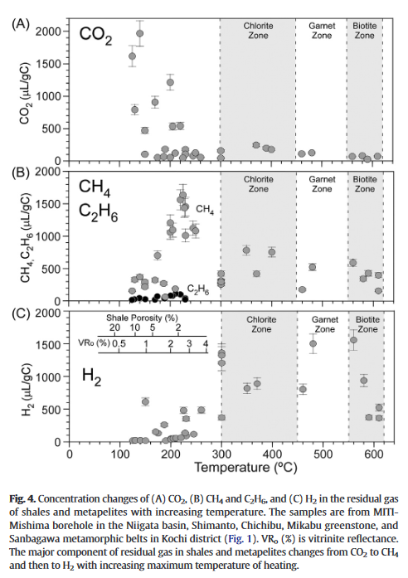
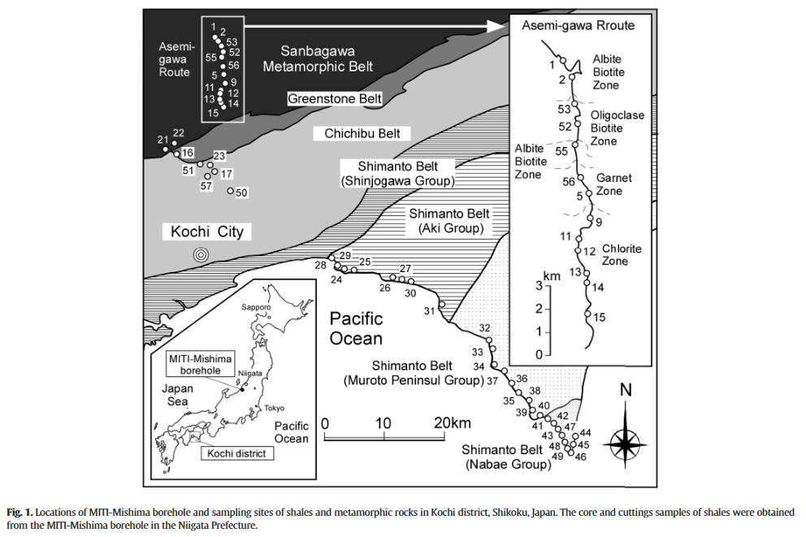
Hydrogen gas of organic origin in shales and metapelites
Carbon dioxide peak pre 250 ⁰C.
Methane declines after 200 ⁰C.
Residual hydrogen detected 2-600 ⁰C.
Residual hydrogen declines as chlorite increases.
Residual hydrogen peaks again in garnet.
Residual hydrogen declines in biotite.
Suzuki, Noriyuki; Saito, Hiroyuki; Hoshino, Taichi (2017). Hydrogen gas of organic origin in shales and metapelites. International Journal of Coal Geology, 173(), 227–236.- doi:10.1016/j.coal.2017.02.014
Notes:
The work by Suzuki and his team shows the volumes of residual gases in shales and metapelites on the west coast of Japan.
Is this the finger print of the hydrogen generation process in action?
Certainly as residual methane subsides around 2-300 residual hydrogen seems to ramp up.
Suzuki favours a direct decomposition of methane method to create diatomic hydrogen.

Slide 36
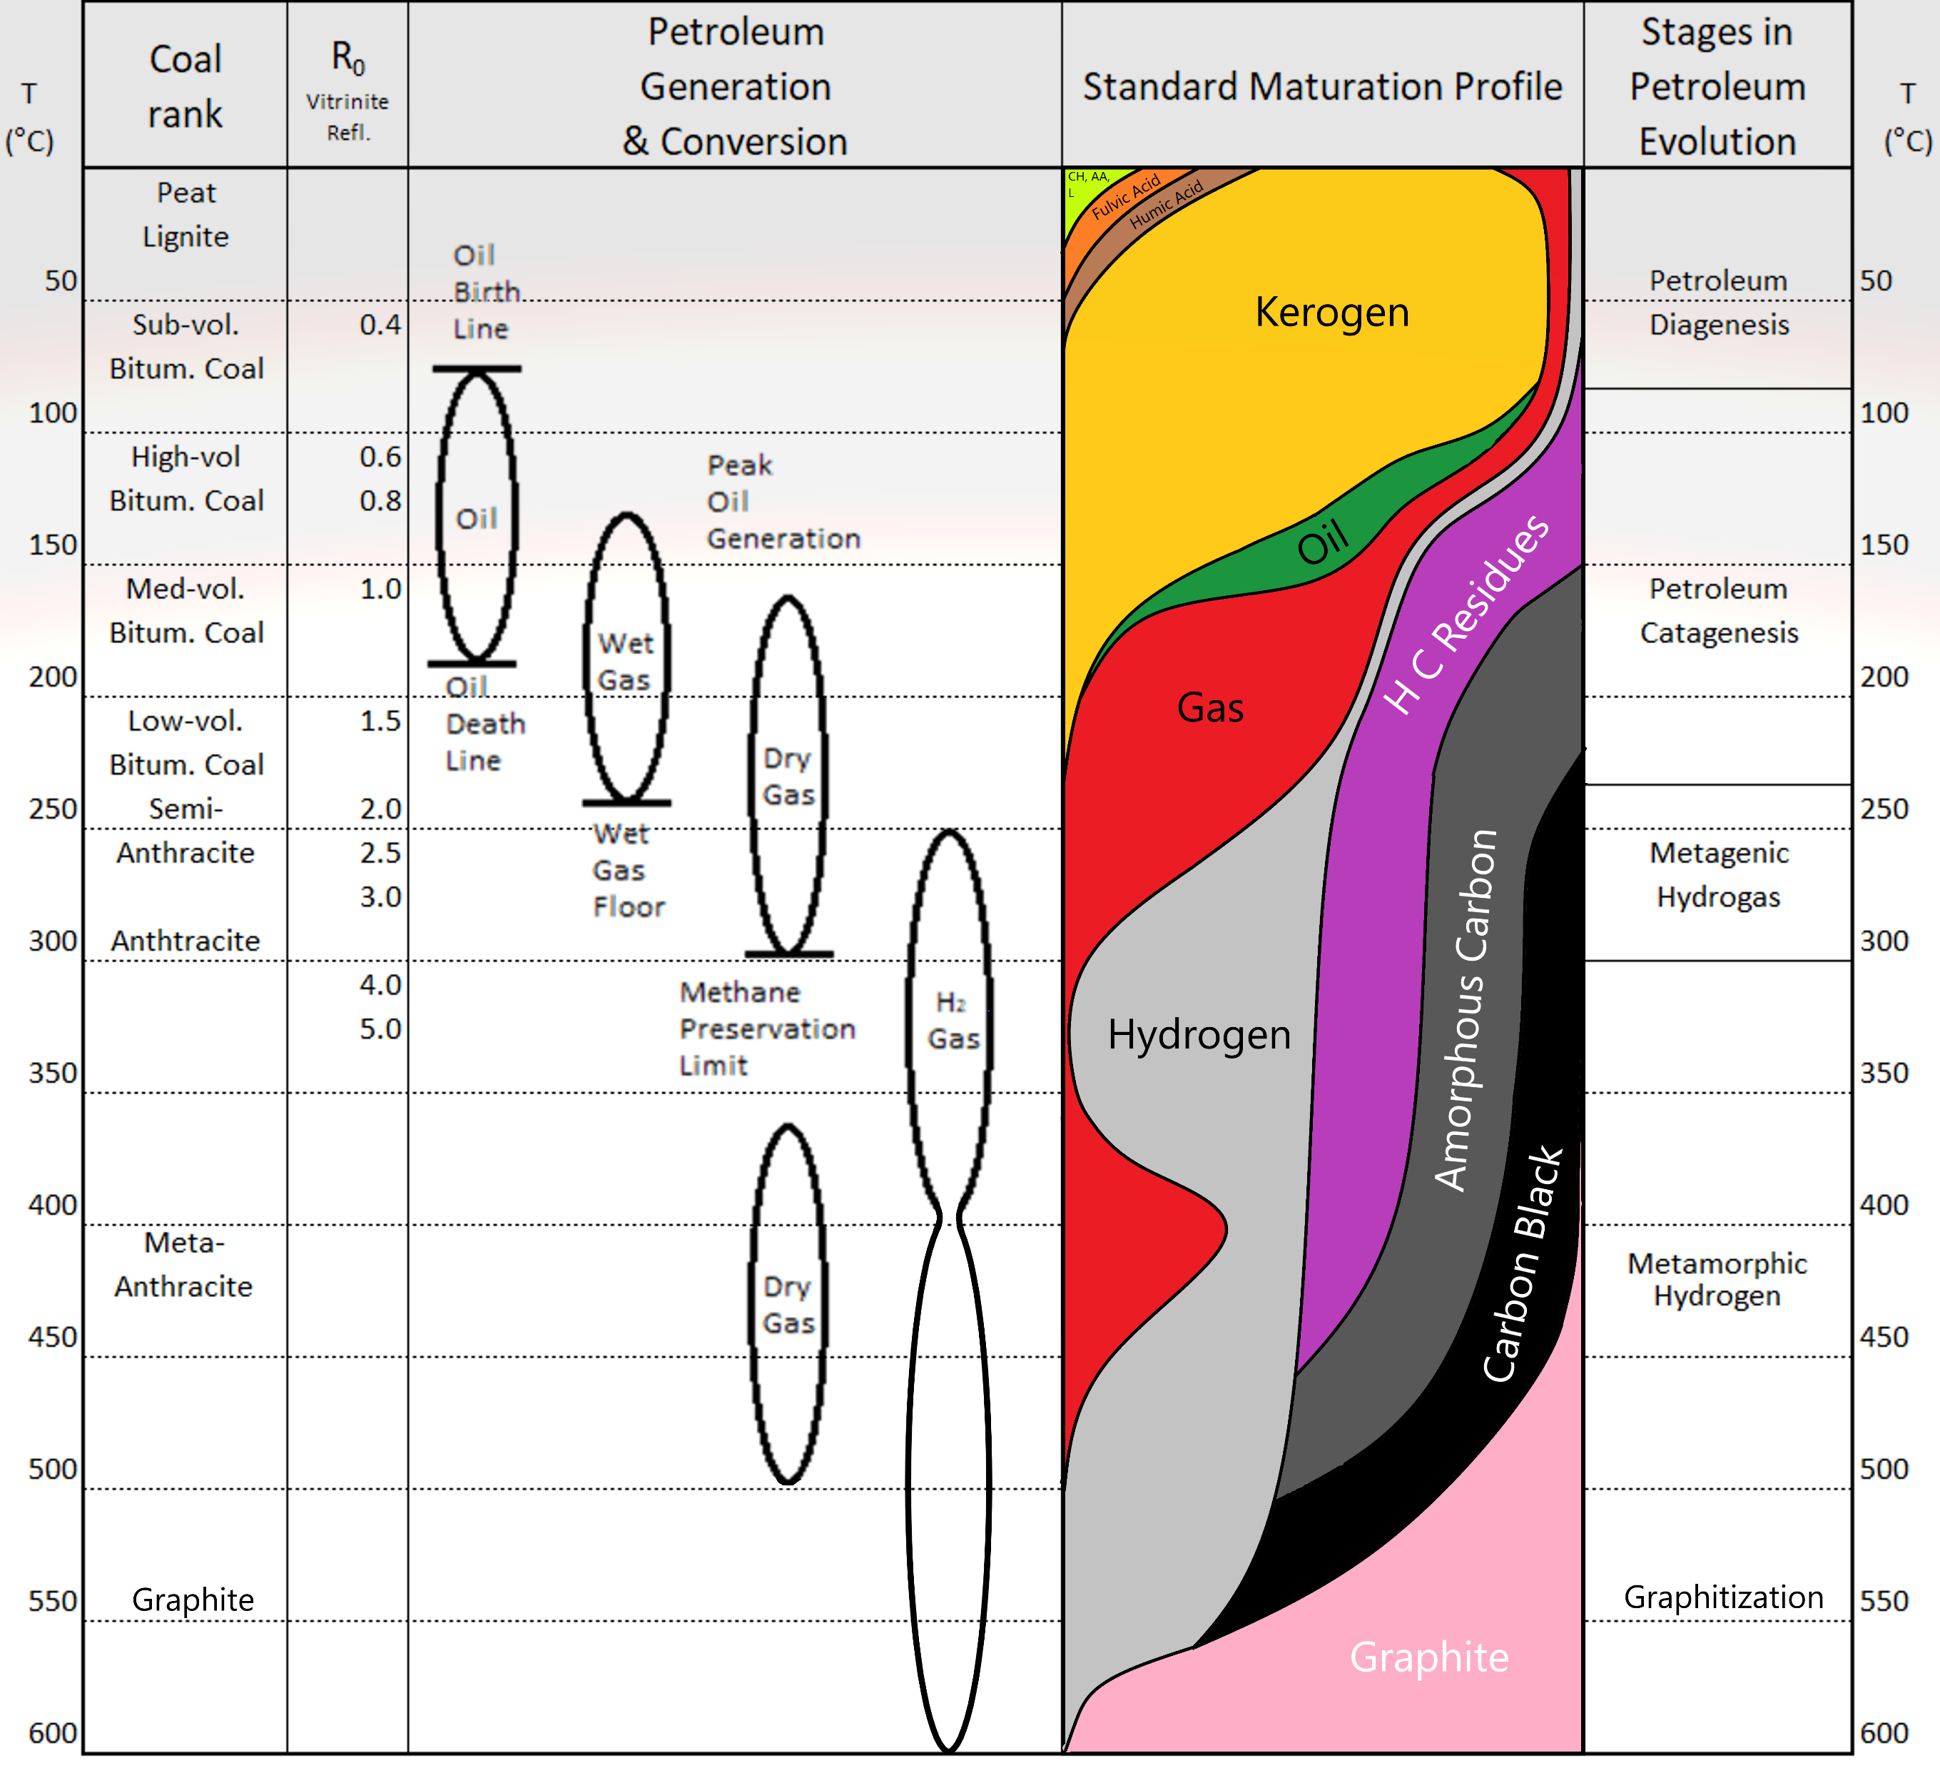
Hydrogen evolution during hydrocarbon generation
Smectite to Illite conversion releases hydronium cracking alkanes and produces 1-2% of diatomic hydrogen during oil and wet gas phase.
Illite creation stops the Whitmore reactions at late stage dry gas zone 2-300 ⁰C. Switch to amorphous carbon in a free radical reaction converting difficult to crack alkanes into diatomic hydrogen and methane.
Supercritical water from chlorite flushes hydrocarbon residues, catalysis by reactivated carbon black releases more diatomic hydrogen.
Notes:
In summary there appear to be three distinct regions were hydrogen can be developed within the hydrocarbon system.
Hydronium and 1-2% of diatomic hydrogen are expelled along with alkanes during oil and wet gas development.
Diatomic hydrogen created by thermo-catalysis of remaining short chained alkanes with amorphous carbon. This is shut down by chlorite development.
Conditions turning super-critical leads to a new gas cap which is turned to diatomic hydrogen by carbon black. Switch off is by biotite generation and leads to graphite as an end product.
There may be some hysteresis of hydrogen development to take account of adsorption, desorption and diffusion.
Hopefully this is convincing enough to make people think before labelling hydrogen in basinal settings as being of “ultramafic origin”.

